Slide 1


SMART INDIA HACKATHON 2024
TITLE PAGE
Problem Statement ID – SIH1752
Problem Statement Title-
Dashboard for Swachhta and LiFE
Theme- Clean & Green Technology
PS Category- Software
Team ID-
Team Name- EcoEngineers

Slide 2
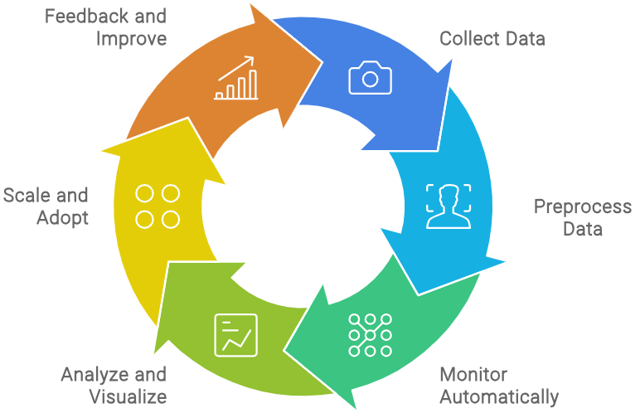
IDEA TITLE
Eco
Engineers
Proposed Solution (Describe your Idea/Solution/Prototype)
SwachhTech is an innovative platform that uses advanced technologies to improve cleanliness and environmental practices.
It uses image-driven insights, AI algorithms, and an intuitive dashboard to monitor cleanliness levels, adherence to Swachhta protocols, and identify anomalies.
The dashboard provides real-time alerts, actionable insights for local teams, administrators and citizens.
It empowers local champions to take ownership and drive positive change, aiming for a greener future with a nationwide network committed to Swachhta.

Slide 3
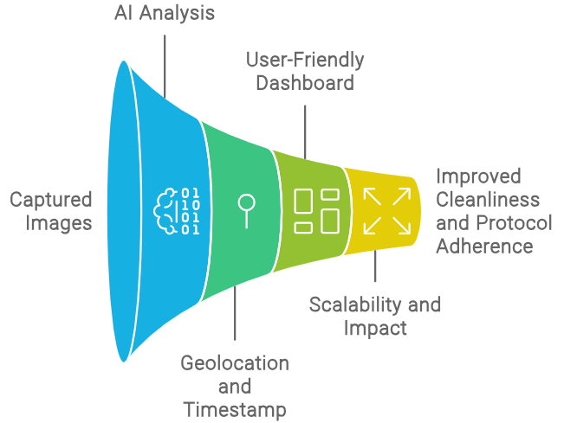
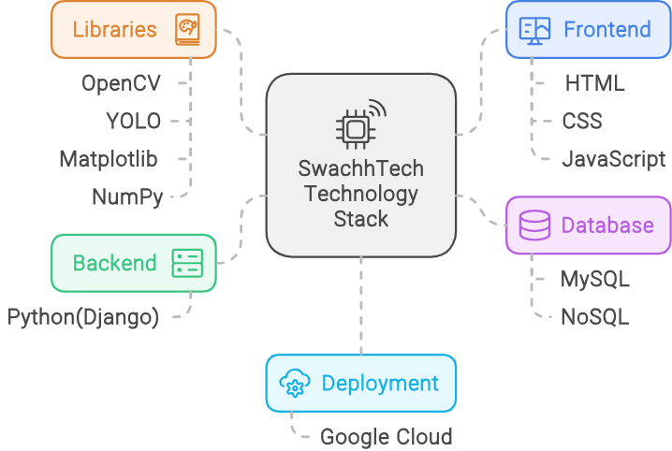
TECHNICAL APPROACH
Eco
Engineers
SwachhTech takes a technical route, utilizing AI-driven image analysis with geolocation data. We use these images to detect cleanliness levels, monitor protocol adherence and alert on anomalies with our algorithms. This geolocation context magnified analyses, complemented by a user-friendly dashboard for on-the-spot choices.

Slide 4
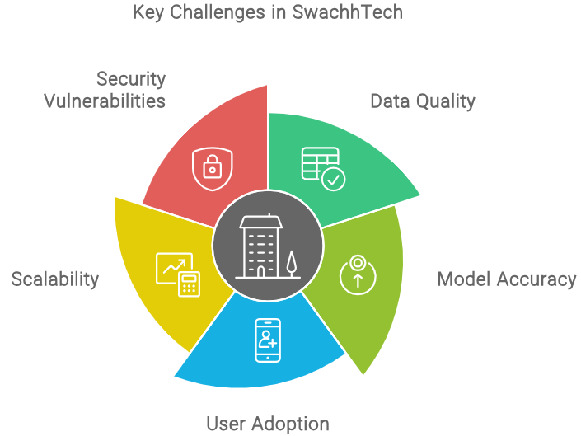
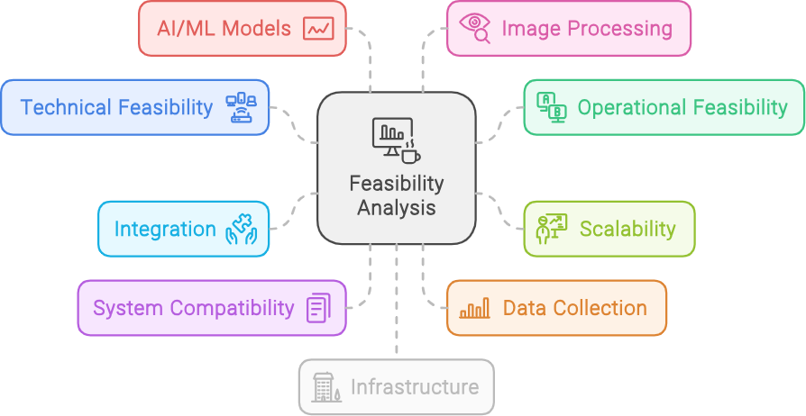
FEASIBILITY AND VIABILITY
Eco
Engineers
Feasibility Analysis: Daily cleanliness indicator data collected at different post office centers. Real-time updates to have sense of single version get View Profile as Page. Enhancing data quality and generalizability of AI models to disparate types of the data.
Viability Analysis: Accurate cleanliness forecasts are an efficient investment in AI/ML that has economic, social and political implications.

Slide 5
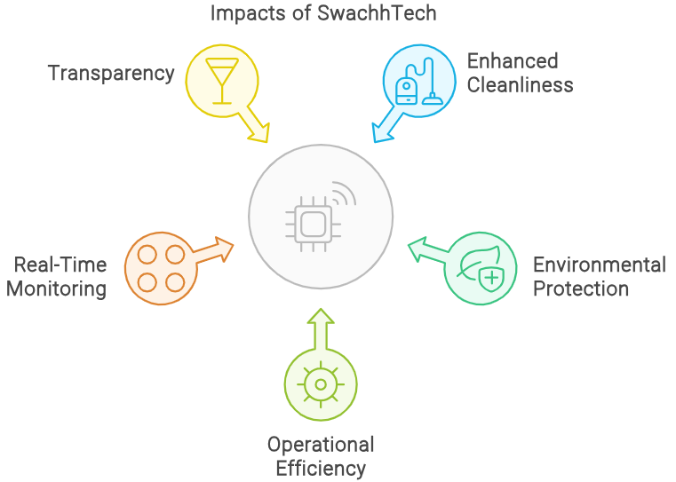
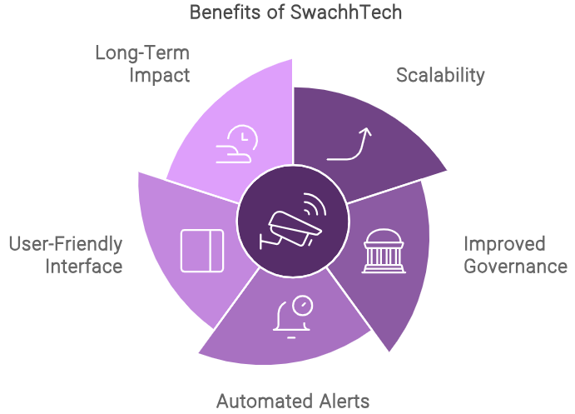
IMPACT AND BENEFITS
Eco
Engineers
SwachhTech offers efficient resource utilization, risk mitigation and sustainable use in the long term. Automated alerts and an intuitive interface will make it easier for the project team to push back quickly against any challenges that might arise, aiding in a more proactive approach.
SwachhTech benefits like maintaining cleanliness and hygiene in post offices, leading to a cleaner environment, reduction of hygiene-related risks for public health safety issues and monitoring the functionality at an operational level.

Slide 6
RESEARCH AND REFERENCES
Eco
Engineers
Journal of Communication Management. Amerendra Kumar Dash and Rajendra Kumar Dash. Published on 5 May 2021. (emerald.com)
Ministry of Communications. Department of Posts exceeds its targets for Swachhta and pending matters by end of Special Campaign 3.0. Posted on 1 Nov 2023. (pib.gov.in)
Green and sustainable AI research: an integrated thematic and topic modeling analysis. Raghu Raman, Debidutta Pattnaik, Hiran H. Lathabai, Chandan Kumar, Kannan Govindan & Prema Nedungadi. Journal of Big Data volume 11, Article number: 55 (2024)
The Role Of Artificial Intelligence (AI) And Green Technology In The Development Of Smart And Sustainable Towns. May 2024. Educational Administration Theory and Practice journal 30(5)

